Slide 1
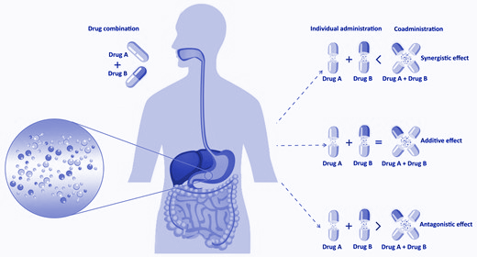
Cancer Drug Synergy Prediction using Graph Convolutional Neural Networks
Machine Learning in Bioinformatics (INFO-I 529)
Spring 2022
Group 2
Nitanshu Joshi
Dhanusha Duraiyan
Supriya Bidanta
Farzaneh Behzadnia
Paveethran Swaminathan

Slide 2
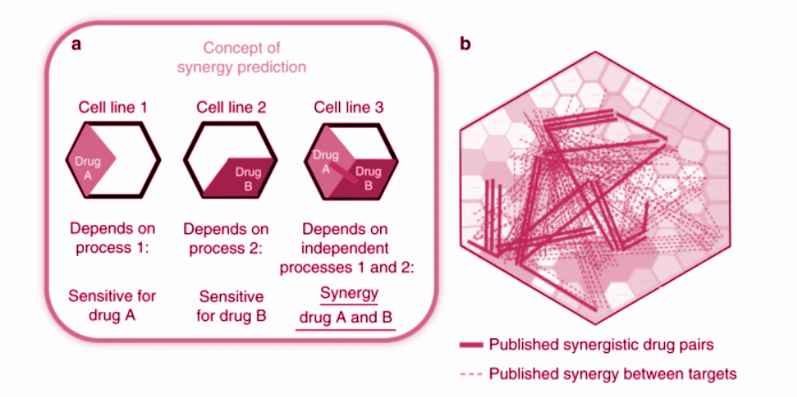
Introduction
Drug A → Specific response for A on cell line
Drug B → Specific response for B on cell line
Synergy of A and B →
Combined response of
A and B on cell line.
Synergy could be additive or inhibitive.

Slide 3
Methods to predict synergy-scores
Naive method: based on clinical experiences - trial and error method
High-throughput Screening (HTS)
Machine learning approach

Slide 4
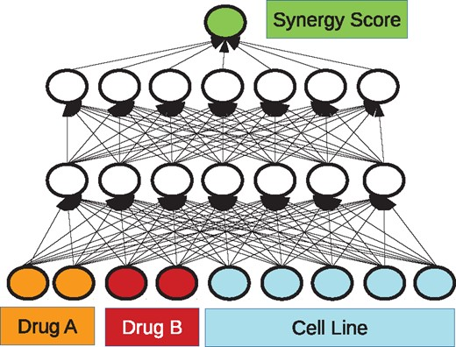
Primary Research Paper
Finding synergistic drug pairs for a particular cancer type is important for improving efficacy of anticancer treatment.
Each sample:
two compounds + a cell line
[Kristina Preuer, Richard P I Lewis, Sepp Hochreiter, Andreas Bender, Krishna C Bulusu, Günter Klambauer, DeepSynergy: predicting anti-cancer drug synergy with Deep Learning, Bioinformatics, Volume 34, Issue 9, 01 May 2018, Pages 1538–1546, https://doi.org/10.1093/bioinformatics/btx806]

Slide 5
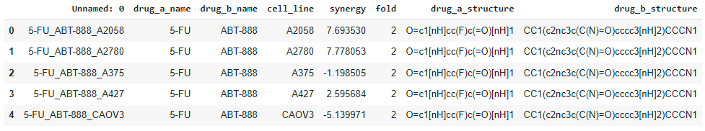
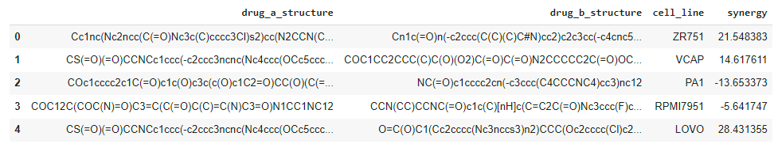
Data: Main Drug Data with Synergy Scores
Drug details: http://www.bioinf.jku.at/software/DeepSynergy/

Slide 6
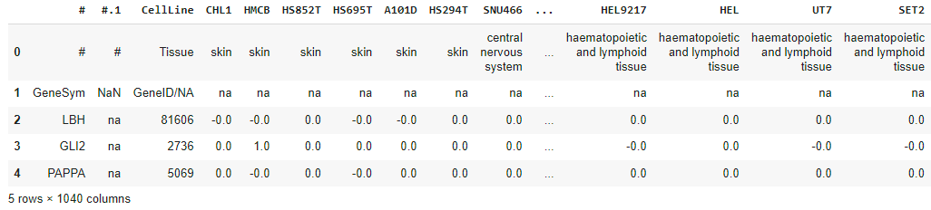
Data: Cancer Cell Line
Cell line: https://sites.broadinstitute.org/ccle/

Slide 7
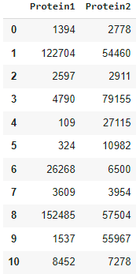
Data: Protein-Protein Interactions
PPI: https://snap.stanford.edu/biodata/datasets/10000/10000-PP-Pathways.html

Slide 8
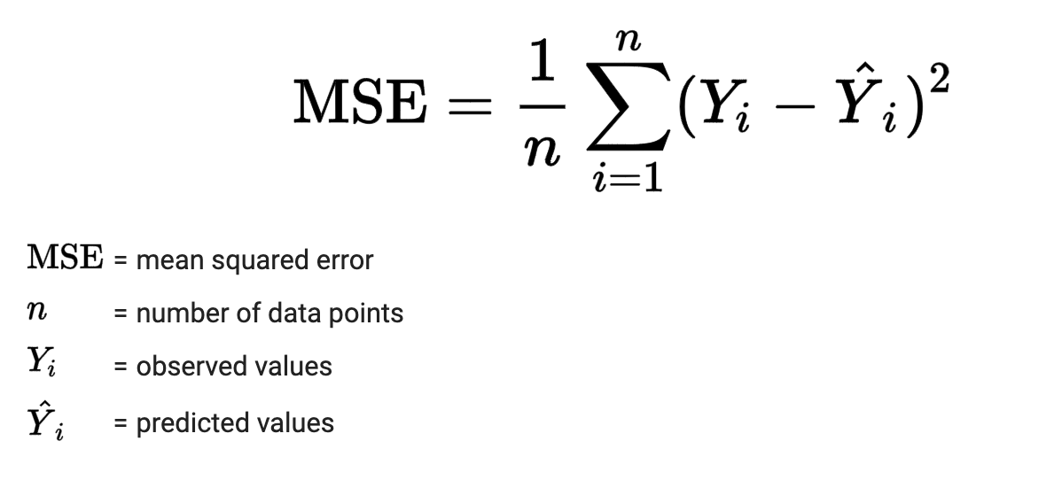
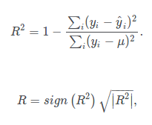
Performance Metrics
Mean Squared Error (MSE): R2 Score:
(Image Source: https://emilia-orellana44.medium.com/not-nice-square-error-2d18c248391c)

Slide 9
Model Architecture
Graph Neural Network - Message Passing Neural Network
Molecular Graph Convolutional Neural Network
And a feed forward neural network that takes input from these two embeddings and predicts a synergy score.

Slide 10
Flow of Modelling
D
R
U
G
S
A
MPNN
Drug A +
Drug B +
Cell-line Embeddings
RESULT
B
MPNN
Synergy Score
C
A
N
C
E
R
Cancer Cell Line
MGCN

Slide 11
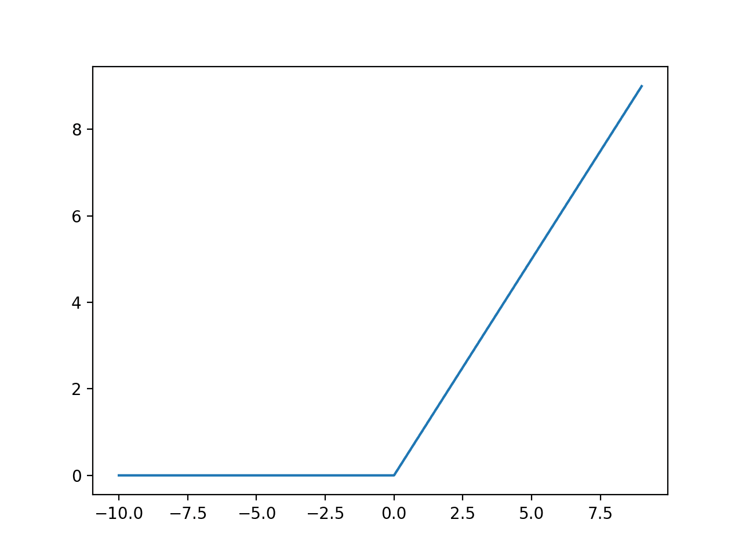
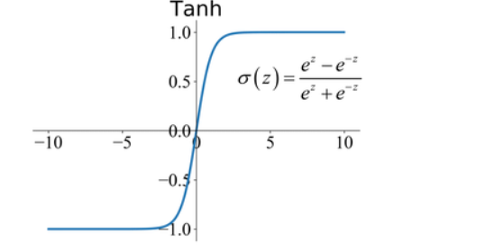
Model: Activation Functions
ReLU: (rectified linear activation unit)
f(x) = max(0, x)
TanH
https://machinelearningmastery.com/wp-content/uploads/2018/10/Line-Plot-of-Rectified-Linear-Activation-for-Negative-and-Positive-Inputs.png
https://www.researchgate.net/figure/Commonly-used-activation-functions-a-Sigmoid-b-Tanh-c-ReLU-and-d-LReLU_fig3_335845675

Slide 12
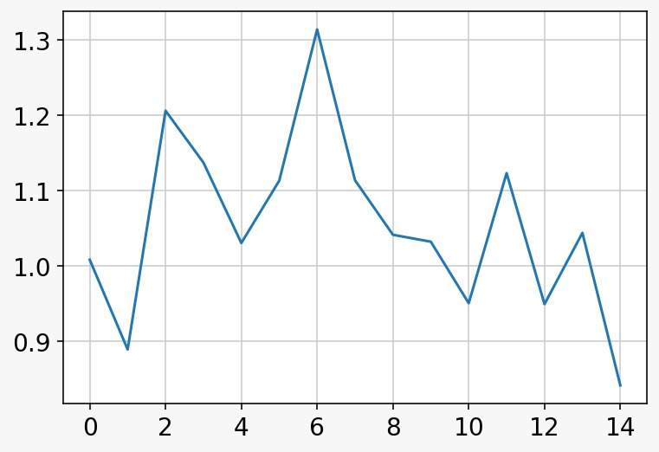
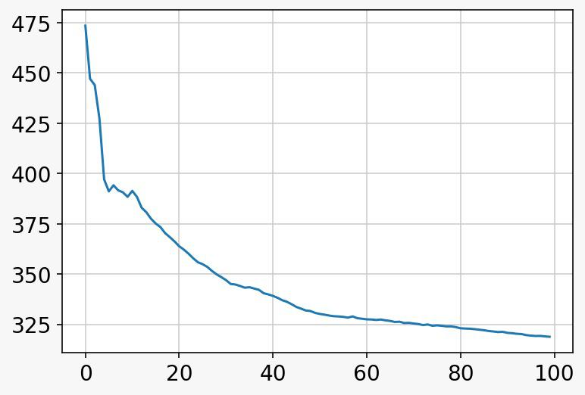
Results: Training Curve
Mean Squared Error
Mean Squared Error
Number of Epochs
Number of Epochs

Slide 13
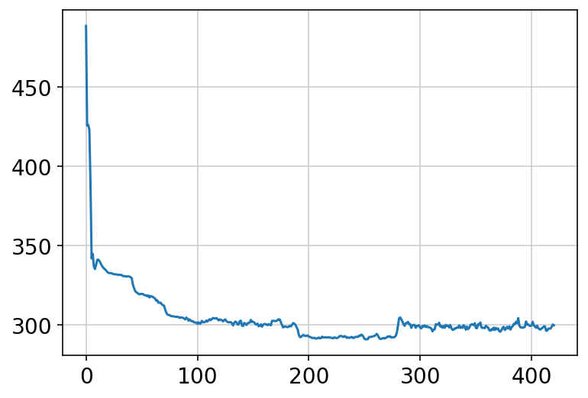

Slide 14
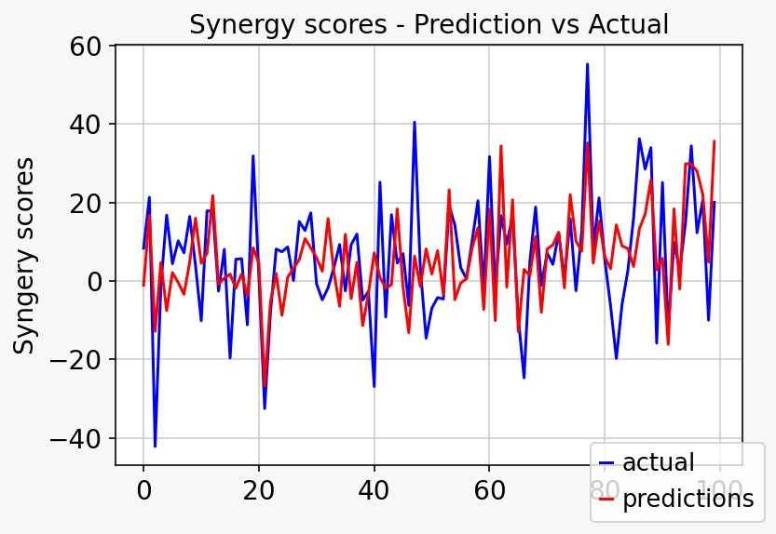
Results: Predictions
Training (MSE) = 318.786
Testing (MSE) = 160.579
Testing R-Squared Value = 0.354

Slide 15
Conclusion:
We have developed a novel graph based deep learning method to predict synergy scores.
Since it requires more number of epochs, this method showed difficulty in generalizing on novel drugs-cell line combination when trained on lower parameters. Also, need to look at other activation functions and also decay weights in some epochs.
We’ve demonstrated that this method can also perform decent enough on external unseen test dataset
Overall, with more improvement, this could be a valuable tool for selecting drug-combinations for cancer cell-lines.

Slide 16
Limitations
Need large number of epochs (at-least 500) to get a good convergence.
Due to the complexity of the model, it requires too much computational time for training.
Since the dataset has only a limited number of different drugs and cell lines all methods show difficulties to generalize well across novel drugs and cell lines.
Evaluating performance of ML models on individual cancer-cell types.
Since the models are extremely complex, their interpretability is difficult.

Slide 17
References:
https://doi.org/10.1093/bib/bbac075
https://doi.org/10.1158/1535-7163.MCT-15-0843
https://doi.org/10.3389/fchem.2019.00509
https://doi.org/10.1093/bioinformatics/btx806
https://www.nature.com/articles/s41598-021-90923-y
https://github.com/KristinaPreuer/DeepSynergy
https://keras.io/examples/graph/mpnn-molecular-graphs/
https://github.com/tkipf/pygcn
http://snap.stanford.edu/deepnetbio-ismb/ipynb/Graph+Convolutional+Prediction+of+Protein+Interactions+in+Yeast.html
https://jhoonline.biomedcentral.com/articles/10.1186/s13045-020-00850-0

